Slide 1

Talk available at
http://uweburghaus.us/
North Dakota State University
Adsorption and reaction of SO₂ and H₂S on graphene/ruthenium(0001) - an ultra-high vacuum surface science study
Thomas Stach, Melody C. Johnson, Samuel Stevens, Uwe Burghaus
Department of Chemistry and Biochemistry, NDSU, Fargo, ND
© 2021, Uwe Burghaus, Fargo, ND, USA
uwe.burghaus@ndsu.edu
Research presented was supported by ND EPSCoR
ND EPSCoR STEM Solicitation – Seed Award
Notes:
Uwe Burghaus
- Surface Chemistry | Het. Catalysis | Nanoscience | Materials -
North Dakota State University, Dept. Chemistry & Biochemistry
uwe.burghaus@ndsu.edu
www.uweburghaus.us
https://www.ndsu.edu/chemistry/people/faculty/burghaus.html
Length of complete talk
25 min
For local ACS. 2021
PAPER ID: 3582909-National ACS, Fall 2021
PAPER TITLE: Adsorption and reaction kinetics of SO2 and H2S on graphene/ruthenium(0001)
DIVISION: Division of Colloid and Surface Chemistry SESSION: Surface Chemistry SESSION
TIME: 4:30 PM - 6:30 PM ET
PRESENTATION FORMAT: Oral - Virtual
DAY & TIME OF PRESENTATION: Thursday, August 26, 2021 from 4:30 PM - 4:50 PM ET (20 min talk)
ROOM & LOCATION: Virtual Room
Adsorption and reaction of SO2 and H2S on graphene/ruthenium(0001) - an ultra-high vacuum surface science study
Noble metal-free catalysis using (functionalized) carbon is an emerging alternative to traditional chemical synthesis. Examples are known for liquid phase and gas-phase reactions. In particular, reactivity towards adsorption and reaction of sulfur compounds has been demonstrated in the literature. However, gas-surface reactions are not well characterized. In this study, kinetics techniques (thermal desorption spectroscopy) and spectroscopy (Auger electron spectroscopy) indeed show that SO2 and H2S undergo chemical transformations on graphene epitaxially grown on ruthenium. In case of SO₂, SO and O₂ desorb, sulfur remains on the surface. In addition, a molecular adsorption pathway is evident.

Slide 2
Motivation – why study surface chemistry of sulfur compounds?
North Dakota State University
Basic science interest
SO₂, is known for its rich and fairly complicated surface chemistry
but
not much surface science information for SO₂, H₂S on graphene
sulfur compounds appear quite reactive on graphene (liquid phase, powder samples, theory)
use in noble metal-free catalysis
Applications
acid rain (sulfuric acid) formation
air pollution (volcanic activity, exhaust gas in power plants/transportation)
corrosion of metals
catalyst poisoning by sulfur
low temperature superconductors
uwe.burghaus@ndsu.edu
Notes:
Noble metals
ruthenium (Ru),
rhodium (Rh),
palladium (Pd),
osmium (Os),
iridium (Ir),
platinum (Pt),
gold (Au),
silver (Ag).
Def.: In chemistry, noble metals are metallic elements that show outstanding resistance to chemical attack even at high temperatures.
https://en.wikipedia.org/wiki/Noble_metal
Uwe Burghaus
- Surface Chemistry | Het. Catalysis | Nanoscience | Materials -
North Dakota State University, Dept. Chemistry & Biochemistry
uwe.burghaus@ndsu.edu
www.uweburghaus.us
https://www.ndsu.edu/chemistry/people/faculty/burghaus.html
Is there any evidence that graphene and functionalized graphene can act as a catalyst?
Given the literature there is no doubt that noble metal free catalysis does work. Examples of noble metal free carbon catalysts are outlined in many published works (see, e.g., refs.¹⁻²¹). Many studies concern synthetic organic chemistry in the liquid phase.²² For example, phenol oxidation by graphene oxide was reported in the liquid phase.¹⁷ Or, the Friedel–Crafts reaction of benzene using mesoporous carbon nitrides is described.¹⁸ Or, graphene oxide was used to catalyze the oxidation of alcohols in the liquid phase.¹⁹ (See e.g. Tabs. 1-2 in ref.²³ for further examples and references.) Importantly, adsorption and reaction processes of sulfur compounds with GO have been studied extensively in the liquid phase^{11, 13, 14, 24-27} as well as theoretically.²⁵
Photocatalytic processes in the gas-phase on graphitic system were reported too such as CO₂ to methanol conversion,²⁸ just to mention one study here. For noble metal free electrocatalysis see e.g. ref.²⁹
Ambient pressure gas phase reactions are also known. For example, mesoporous carbon acts as a metal-free catalyst for the low-temperature H₂S oxidation by doping the carbon catalyst with nitrogen atoms.¹⁶ Ref.³⁰ describes a high pressure study on an apparently thick layer of supported commercial GO flakes. On that system, CO oxidation (as a gas-surface reaction) was seen successfully at high pressure conditions.³⁰ On N and S doped graphene flakes NO dissociation was seen using a fixed-bed reactor.²⁰
In addition, many theoretical studies suggest that graphene and graphene oxide can work as a catalyst. For example, SO₂ oxidation by graphene oxide was considered by density functional theory (DFT).²⁵ In another DFT study an enhancement of NO_{x} and N₂O₂ adsorption on hydroxyl and carbonyl covered GO, compared with graphene, was theoretically predicted. Here hydrogen bond formation and even weak covalent bonds (by hybridization of NO_{x} and GO bonds) were invoked.³¹ Similar theoretical results were reported about ammonia (NH₃) adsorption on GO.³²
Non carbon but noble metal free catalysts are also known.³³
Molecular adsorption was studied also experimentally on (functionalized) graphene³⁴⁻⁴³ but, experimental UHV surface science work characterizing surface reactions has apparently not been conducted, except our own works.⁴⁴
A concern often voiced is whether graphene can really act as a catalyst in these processes. In some of the literature examples just discussed, the reactions may be stoichiometric, but also examples are known where graphene clearly acts as a catalyst. Citing directly the review about graphene in organic liquid phase reactions:²² “… GO was recovered and reused for nine catalytic cycles...” (see page 11474, right column, ref.²²) That exactly is the definition of a catalyst. That citation concerns Michael addition reactions, similar results were obtained for C–H bond activation of aryl halides (see page 11475, left column in the same review). For other examples, see e.g. refs.⁴⁵ (defects in graphene acting as active sites), ref. ^{34, 35} (enhanced CO adsorption, graphene was not altered, i.e., the process is catalytic), ref.¹⁵ (Si doped graphene catalyzing CO oxidation), etc.
References
1 Su, D. S., Zhang, J., Frank, B., Thomas, A., Wang, X., Paraknowitsch, J. Schloegel, R., "Metal-Free Heterogeneous Catalysis for Sustainable Chemistry (review)" ChemSusChem 3, 169–180, (2010).
2 Schreiner, P. R., "Metal-free organocatalysis through explicit hydrogen bonding interactions" Chem. Soc. Rev. 32, 289–296., (2003).
3 Zhang, J., Su, D., Zhang, A., Wang, D., Schloegel, R. Hbert, C., "Nanocarbon as Robust Catalyst: Mechanistic Insight into Carbon-Mediated Catalysis" Angew. Chem. Int. Ed. 46, 7319 –7323, (2007).
4 Wang, Y., Li, H., Yao, J., Wanga, X. Antoniettia, M., "Synthesis of boron doped polymeric carbon nitride solids and their use as metal-free catalysts for aliphatic C–H bond oxidation" Chem. Sci. 2, 446–450, (2011).
5 Xiaoyan, S., Rui, W. Dangsheng, S., "Research progress in metal-free carbon-based catalysts" Chinese Journal of Catalysis 34, 508–523, (2013).
6 Qi, W. Su, D., "Metal-Free Carbon Catalysts for Oxidative Dehydrogenation Reactions" ACS Catal. 4, 3212−3218, (2014).
7 Sun, H., Wang, Y., Liu, S., Ge, L., Wang, L., Zhub, Z. Wang, S., "Facile synthesis of nitrogen doped reduced graphene oxide as a superior metal-free catalyst for oxidation" Chem. Commun. 49, 9914-9916, (2013).
8 Sakaushi, K., Fellinger, T. P. Antonietti, M., "Bifunctional Metal-Free Catalysis of Mesoporous Noble Carbons for Oxygen Reduction and Evolution Reactions" ChemSusChem 8, 1156 – 1160, (2015).
9 Zhang, M. Dain, L., "Carbon nanomaterials as metal-free catalysts in next generation fuel cells" Nano Energy 1, 514–517, (2012).
10 Dai, L., Xue, Y., Qu, L., Choi, H. Baek, J., "Metal-Free Catalysts for Oxygen Reduction Reaction" Chem. Rev. 115, 4823−4892, (2015).
11 Zhai, C., Sun, M., Zhua, M., Song, S. Jiang, S., "A new method to synthesize sulfur-doped graphene as effectivemetal-free electrocatalyst for oxygen reduction reaction" Applied Surface Science 407, 503–508, (2017).
12 Tang, Y., Chen, W., Shen, Z., Chang, S., Zhao, M. Dai, X., "Nitrogen coordinated silicon-doped graphene as a potential alternative metal-free catalyst for CO oxidation" Carbon 111, 448-458, (2017).
13 Zhao, Q., Mao, Q., Zhou, Y., Wei, J., Liu, X., Yang, J., Luo, L., Zhang, J., Chen, H., Chen, H. Tang, L., "Review: Metal-free carbon materials-catalyzed sulfate radical-based advanced oxidation processes: A review on heterogeneous catalysts and applications" Chemosphere 189, 224-238, (2017).
14 Esrafili, M. D., Saeidi, N. Nematollahi, P., "Si-doped graphene: A promising metal-free catalystfor oxidation of SO₂" Chemical Physics Letters 649, 37–43, (2016).
15 Tang, Y., Liu, Z., Dai, X., Yang, Z., Chen, W., Ma, D. Lu, Z., "Theoretical study on the Si-doped graphene as an efficient metal-freecatalyst for CO oxidation" Applied Surface Science 308, 402–407, (2014).
16 Sun, F., Liu, J., Chen, H., Zhang, Z., Qiao, W., Long, D. Ling, L., "Nitrogen-Rich Mesoporous Carbons: Highly Efficient, Regenerable Metal-Free Catalysts for Low-Temperature Oxidation of H₂S" ACS Catal. 3, 862−870, (2013).
17 Komeily-Nia, Z., Chen, J. Y., Nasri-Nasrabadi, B., Lei, W. W., Yuan, B., Zhang, J., Qu, L. T., Gupta, A. Li, J. L., "The key structural features governing the free radicals and catalytic activity of graphite/graphene oxide" Phys.Chem.Chem.Phys. 22, 3112, (2020).
18 Goettmann, F., Fischer, A., Antonietti, M. Thomas, A., "Chemical Synthesis of Mesoporous Carbon Nitrides Using Hard Templates and Their Use as a Metal-Free Catalyst for Friedel–Crafts Reaction of Benzene" Angew. Chem. Int. Ed. 45, 4467–4471, (2006).
19 Dreyer, D. R., Jia, H. P. Bielawski, C. W., "Graphene Oxide: A Convenient Carbocatalyst for Facilitating Oxidation and Hydration Reactions" Angew. Chem. 122, 6965 –6968, (2010).
20 Wang, Y., Shen, Y., Zhou, Y., Xue, Z., Xi, Z. Zhu, S., "Heteroatom-Doped Graphene for Efficient NO Decomposition by Metal-Free Catalysis" ACS Appl. Mater. Interfaces 10, 36202−36210, (2018).
21 Wu, S., Yu, L., Wen, G., Xie, Z. Lin, Y., "Recent progress of carbon-based metal-free materials in thermal-driven catalysis" Journal of Energy Chemistry 58, 318–335, (2021).
22 Mohammadi, O., Golestanzadeh, M. Abdouss, M., "Recent advances in organic reactions catalyzed by graphene oxide and sulfonated graphene as heterogeneous nanocatalysts: a review" New J. Chem. 41, 11471--11497, (2017).
23 Su, C. Loh, K. P., "Carbocatalysts: Graphene Oxide and Its Derivatives" Acc. Chem. Res. 46, 2275–2285, (2013).
24 Long, Y., Zhang, C., Wang, X., Gao, J., Wang, W. Liu, Y., "Oxidation of SO₂ to SO₃ catalyzed by graphene oxide foams" J. Mater. Chem. 21, 13934, (2011).
25 He, G. He, H., "DFT studies on the heterogeneous oxidation of SO₂ by oxygen functional groups on graphene" Phys. Chem. Chem. Phys. 18, 31691--31697 (2016).
26 Gotterbarm, K., Spath, F., Bauer, U., Steinruck, H. P. Papp, C., "Adsorption and Reaction of SO₂ on Graphene-Supported Pt Nanoclusters" Top Catal 58, 573–579, (2015).
27 Rad, A. S. Zareyee, D., "Adsorption properties of SO₂ and O₃ molecules on Pt-decorated graphene: A theoretical study" Vacuum 130, 113-118, (2016).
28 Hsu, H.-C., Shown, I., Wei, H.-Y., Chang, Y.-C., Du, H.-Y., Lin, Y.-G., Tseng, C.-A., Wang, C.-H., Chen, L.-C., Lind, Y.-C. Chen, K.-H., "Graphene oxide as a promising photocatalyst for CO₂ to methanol conversion" Nanoscale 5, 262, (2013).
29 Wang, J., Wang, P., Wang, S. Li, J., "A metal-free catalyst: sulfur-doped and sulfur nanoparticle-modified CMK-3 as an electrocatalyst for enhanced N₂-fixation" New J. Chem. 44, 20935, (2020).
30 Narayanan, B., Weeksa, S. L., Jariwala, B. N., Macco, B., Weber, J. W., Rathi, S. J., Sanden, M. C. M., Sutter, P., Agarwal, S. Ciobanu, C. V., "Carbon monoxide-induced reduction and healing of graphene oxide" Journal of Vacuum Science & Technology A31, 040601 (2013).
31 Tang, S. Cao, Z., "Adsorption of nitrogen oxides on graphene and graphene oxides: Insights from density functional calculations" THE JOURNAL OF CHEMICAL PHYSICS 134, 044710, (2011).
32 Tang, S. Cao, Z., "Adsorption and Dissociation of Ammonia on Graphene Oxides: A First-Principles Study" J. Phys. Chem. C 116, 8778−8791, (2012).
33 Royer, S., Duprez, D., Can, F., Courtois, X., Batiot-Dupeyrat, C., Laassiri, S. Alamdari, H., "Perovskites as Substitutes of Noble Metals for Heterogeneous Catalysis: Dream or Reality" Chem. Rev. 114, 10292−10368, (2014).
34 Elias, D. C., Nair, R. R., Mohiuddin, T. Morozov, S. V., "Control of graphene's properties by reversible hydrogenation: evidence for graphane" Science 323, 610-613, (2009).
35 Balog, R., Jørgensen, B., Wells, J., Lægsgaard, E., Hofmann, P., Besenbacher, F. Hornekær, L., "Atomic Hydrogen Adsorbate Structures on Graphene" J. AM. CHEM. SOC. 131, 8744–8745, (2009).
36 Sivapragasam, N., Nayakasinghe, M. T. Burghaus, U., "Adsorption Kinetics and Dynamics of CO₂ on Ru(0001) Supported Graphene Oxide" Journal of Physical Chemistry C 120, 28049–28056, (2016).
37 Chakradhar, A., Sivapragasam, N., Nayakasinghe, M. T. Burghaus, U., "Adsorption Kinetics of Benzene on Graphene: an Ultra-high Vacuum Study" Journal of Vacuum Science & Technology A 34, 021402, (2016).
38 Sivapragasam, N., Nayakasinghe, M. T. Burghaus, U., "Adsorption of n-butane on graphene/Ru(0001)—A molecular beam scattering study" J. Vac. Sci. Technol. 34, 041404, (2016).
39 Chakradhar, A. Burghaus, U., "Adsorption of water on graphene/Ru(0001)—an experimental ultra-high vacuum study" Chemical Communications 50, 7698 - 7701, (2014).
40 Burghaus, U., "Adsorption of water on two-dimensional crystals: water/graphene and water/silicatene (short review)" Inorganics 4, 10; http://www.mdpi.com/2304-6740/4/2/10/pdf (2016).
41 Chakradhar, A., Trettel, K. M. Burghaus, U., "Benzene adsorption on Ru(0001) and graphene/Ru(0001) — How to synthesize epitaxial graphene without STM or LEED?" Chemical Physics Letters 590, 146-152, (2013).
42 Sivapragasam, N., Nayakasinghe, M. T., Chakradhar, A. Burghaus, U., "Effects of the support on the desorption kinetics of n-pentane from graphene: an ultra-high vacuum adsorption study" J. Vac. Sci. Technol. A 35, 061404, (2017).
43 Chakradhar, A., Sivapragasam, N., Nayakasinghe, M. T. Burghaus, U., "Support effects in the adsorption of water on CVD graphene: an ultra-high vacuum adsorption study," Chemical Communications 51, 11463 - 11466, (2015).
44 Stach, T., Johnson, M. C., Stevens, S. Burghaus, U., "Adsorption Kinetics of SO₂ on Graphene: an Ultra-high Vacuum Surface Science Study" submitted (2021).
45 Widjaja, H., Oluwoye, I., Altarawneh, M., Hamra, A. A. B., Lim, H. N., Huang, N. M., Yin, C. Y. Jiang, Z. T., "Phenol dissociation on pristine and defective graphene" Surface Science 657, 10-14, (2017).
low temperature superconductors – sulfur doped carbon
https://www.nature.com/articles/s41586-020-2801-z
Snider, E., Dasenbrock-Gammon, N., McBride, R. et al. Room-temperature superconductivity in a carbonaceous sulfur hydride. Nature 586, 373–377 (2020). https://doi.org/10.1038/s41586-020-2801-z

Slide 3
Can graphene act as a catalyst?
North Dakota State University
synthetic organic chemistry in the liquid phase
  phenol oxidation by graphene oxide
  Friedel–Crafts reaction of benzene using mesoporous carbon nitrides
  oxidation of alcohols in the liquid phase
  & many more
gas-surface reactions
  Photocatalytic CO₂ to methanol conversion
  H₂S oxidation by N-doped graphene
  CO oxidation on graphene flakes
  NO dissociation on S-doped graphene
It does work using graphene as a catalyst.
electrocatalysis
photochemistry
But, UHV surface science studies are rare.
uwe.burghaus@ndsu.edu
Notes:
Noble metals
ruthenium (Ru),
rhodium (Rh),
palladium (Pd),
osmium (Os),
iridium (Ir),
platinum (Pt),
gold (Au),
silver (Ag).
Def.: In chemistry, noble metals are metallic elements that show outstanding resistance to chemical attack even at high temperatures.
https://en.wikipedia.org/wiki/Noble_metal
Uwe Burghaus
- Surface Chemistry | Het. Catalysis | Nanoscience | Materials -
North Dakota State University, Dept. Chemistry & Biochemistry
uwe.burghaus@ndsu.edu
www.uweburghaus.us
https://www.ndsu.edu/chemistry/people/faculty/burghaus.html
Is there any evidence that graphene and functionalized graphene can act as a catalyst?
Given the literature there is no doubt that noble metal free catalysis does work. Examples of noble metal free carbon catalysts are outlined in many published works (see, e.g., refs.¹⁻²¹). Many studies concern synthetic organic chemistry in the liquid phase.²² For example, phenol oxidation by graphene oxide was reported in the liquid phase.¹⁷ Or, the Friedel–Crafts reaction of benzene using mesoporous carbon nitrides is described.¹⁸ Or, graphene oxide was used to catalyze the oxidation of alcohols in the liquid phase.¹⁹ (See, e.g., Tabs. 1-2 in ref.²³ for further examples and references.) Importantly, adsorption and reaction processes of sulfur compounds with GO have been studied extensively in the liquid phase^{11, 13, 14, 24-27} as well as theoretically.²⁵
Photocatalytic processes in the gas-phase on graphitic system were reported too such as CO₂ to methanol conversion,²⁸ just to mention one study here. For noble metal free electrocatalysis see, e.g., ref.²⁹
Ambient pressure gas phase reactions are also known. For example, mesoporous carbon acts as a metal-free catalyst for the low-temperature H₂S oxidation by doping the carbon catalyst with nitrogen atoms.¹⁶ Ref.³⁰ describes a high-pressure study on an apparently thick layer of supported commercial GO flakes. On that system, CO oxidation (as a gas-surface reaction) was seen successfully at high pressure conditions.³⁰ On N and S doped graphene flakes NO dissociation was seen using a fixed-bed reactor.²⁰
In addition, many theoretical studies suggest that graphene and graphene oxide can work as a catalyst. For example, SO₂ oxidation by graphene oxide was considered by density functional theory (DFT).²⁵ In another DFT study an enhancement of NO_{x} and N₂O₂ adsorption on hydroxyl and carbonyl covered GO, compared with graphene, was theoretically predicted. Here hydrogen bond formation and even weak covalent bonds (by hybridization of NO_{x} and GO bonds) were invoked.³¹ Similar theoretical results were reported about ammonia (NH₃) adsorption on GO.³²
Non carbon but noble metal free catalysts are also known.³³
Molecular adsorption was studied also experimentally on (functionalized) graphene³⁴⁻⁴³ but, experimental UHV surface science work characterizing surface reactions has apparently not been conducted, except our own works.⁴⁴
A concern often voiced is whether graphene can really act as a catalyst in these processes. In some of the literature examples just discussed, the reactions may be stoichiometric, but also examples are known where graphene clearly acts as a catalyst. Citing directly the review about graphene in organic liquid phase reactions:²² “… GO was recovered and reused for nine catalytic cycles...” (see page 11474, right column, ref.²²) That exactly is the definition of a catalyst. That citation concerns Michael addition reactions, similar results were obtained for C–H bond activation of aryl halides (see page 11475, left column in the same review). For other examples, see e.g. refs.⁴⁵ (defects in graphene acting as active sites), ref. ^{34, 35} (enhanced CO adsorption, graphene was not altered, i.e., the process is catalytic), ref.¹⁵ (Si doped graphene catalyzing CO oxidation), etc.
References
1 Su, D. S., Zhang, J., Frank, B., Thomas, A., Wang, X., Paraknowitsch, J. Schloegel, R., "Metal-Free Heterogeneous Catalysis for Sustainable Chemistry (review)" ChemSusChem 3, 169–180, (2010).
2 Schreiner, P. R., "Metal-free organocatalysis through explicit hydrogen bonding interactions" Chem. Soc. Rev. 32, 289–296., (2003).
3 Zhang, J., Su, D., Zhang, A., Wang, D., Schloegel, R. Hbert, C., "Nanocarbon as Robust Catalyst: Mechanistic Insight into Carbon-Mediated Catalysis" Angew. Chem. Int. Ed. 46, 7319 –7323, (2007).
4 Wang, Y., Li, H., Yao, J., Wanga, X. Antoniettia, M., "Synthesis of boron doped polymeric carbon nitride solids and their use as metal-free catalysts for aliphatic C–H bond oxidation" Chem. Sci. 2, 446–450, (2011).
5 Xiaoyan, S., Rui, W. Dangsheng, S., "Research progress in metal-free carbon-based catalysts" Chinese Journal of Catalysis 34, 508–523, (2013).
6 Qi, W. Su, D., "Metal-Free Carbon Catalysts for Oxidative Dehydrogenation Reactions" ACS Catal. 4, 3212−3218, (2014).
7 Sun, H., Wang, Y., Liu, S., Ge, L., Wang, L., Zhub, Z. Wang, S., "Facile synthesis of nitrogen doped reduced graphene oxide as a superior metal-free catalyst for oxidation" Chem. Commun. 49, 9914-9916, (2013).
8 Sakaushi, K., Fellinger, T. P. Antonietti, M., "Bifunctional Metal-Free Catalysis of Mesoporous Noble Carbons for Oxygen Reduction and Evolution Reactions" ChemSusChem 8, 1156 – 1160, (2015).
9 Zhang, M. Dain, L., "Carbon nanomaterials as metal-free catalysts in next generation fuel cells" Nano Energy 1, 514–517, (2012).
10 Dai, L., Xue, Y., Qu, L., Choi, H. Baek, J., "Metal-Free Catalysts for Oxygen Reduction Reaction" Chem. Rev. 115, 4823−4892, (2015).
11 Zhai, C., Sun, M., Zhua, M., Song, S. Jiang, S., "A new method to synthesize sulfur-doped graphene as effectivemetal-free electrocatalyst for oxygen reduction reaction" Applied Surface Science 407, 503–508, (2017).
12 Tang, Y., Chen, W., Shen, Z., Chang, S., Zhao, M. Dai, X., "Nitrogen coordinated silicon-doped graphene as a potential alternative metal-free catalyst for CO oxidation" Carbon 111, 448-458, (2017).
13 Zhao, Q., Mao, Q., Zhou, Y., Wei, J., Liu, X., Yang, J., Luo, L., Zhang, J., Chen, H., Chen, H. Tang, L., "Review: Metal-free carbon materials-catalyzed sulfate radical-based advanced oxidation processes: A review on heterogeneous catalysts and applications" Chemosphere 189, 224-238, (2017).
14 Esrafili, M. D., Saeidi, N. Nematollahi, P., "Si-doped graphene: A promising metal-free catalystfor oxidation of SO₂" Chemical Physics Letters 649, 37–43, (2016).
15 Tang, Y., Liu, Z., Dai, X., Yang, Z., Chen, W., Ma, D. Lu, Z., "Theoretical study on the Si-doped graphene as an efficient metal-freecatalyst for CO oxidation" Applied Surface Science 308, 402–407, (2014).
16 Sun, F., Liu, J., Chen, H., Zhang, Z., Qiao, W., Long, D. Ling, L., "Nitrogen-Rich Mesoporous Carbons: Highly Efficient, Regenerable Metal-Free Catalysts for Low-Temperature Oxidation of H₂S" ACS Catal. 3, 862−870, (2013).
17 Komeily-Nia, Z., Chen, J. Y., Nasri-Nasrabadi, B., Lei, W. W., Yuan, B., Zhang, J., Qu, L. T., Gupta, A. Li, J. L., "The key structural features governing the free radicals and catalytic activity of graphite/graphene oxide" Phys.Chem.Chem.Phys. 22, 3112, (2020).
18 Goettmann, F., Fischer, A., Antonietti, M. Thomas, A., "Chemical Synthesis of Mesoporous Carbon Nitrides Using Hard Templates and Their Use as a Metal-Free Catalyst for Friedel–Crafts Reaction of Benzene" Angew. Chem. Int. Ed. 45, 4467–4471, (2006).
19 Dreyer, D. R., Jia, H. P. Bielawski, C. W., "Graphene Oxide: A Convenient Carbocatalyst for Facilitating Oxidation and Hydration Reactions" Angew. Chem. 122, 6965 –6968, (2010).
20 Wang, Y., Shen, Y., Zhou, Y., Xue, Z., Xi, Z. Zhu, S., "Heteroatom-Doped Graphene for Efficient NO Decomposition by Metal-Free Catalysis" ACS Appl. Mater. Interfaces 10, 36202−36210, (2018).
21 Wu, S., Yu, L., Wen, G., Xie, Z. Lin, Y., "Recent progress of carbon-based metal-free materials in thermal-driven catalysis" Journal of Energy Chemistry 58, 318–335, (2021).
22 Mohammadi, O., Golestanzadeh, M. Abdouss, M., "Recent advances in organic reactions catalyzed by graphene oxide and sulfonated graphene as heterogeneous nanocatalysts: a review" New J. Chem. 41, 11471--11497, (2017).
23 Su, C. Loh, K. P., "Carbocatalysts: Graphene Oxide and Its Derivatives" Acc. Chem. Res. 46, 2275–2285, (2013).
24 Long, Y., Zhang, C., Wang, X., Gao, J., Wang, W. Liu, Y., "Oxidation of SO₂ to SO₃ catalyzed by graphene oxide foams" J. Mater. Chem. 21, 13934, (2011).
25 He, G. He, H., "DFT studies on the heterogeneous oxidation of SO₂ by oxygen functional groups on graphene" Phys. Chem. Chem. Phys. 18, 31691--31697 (2016).
26 Gotterbarm, K., Spath, F., Bauer, U., Steinruck, H. P. Papp, C., "Adsorption and Reaction of SO₂ on Graphene-Supported Pt Nanoclusters" Top Catal 58, 573–579, (2015).
27 Rad, A. S. Zareyee, D., "Adsorption properties of SO₂ and O₃ molecules on Pt-decorated graphene: A theoretical study" Vacuum 130, 113-118, (2016).
28 Hsu, H.-C., Shown, I., Wei, H.-Y., Chang, Y.-C., Du, H.-Y., Lin, Y.-G., Tseng, C.-A., Wang, C.-H., Chen, L.-C., Lind, Y.-C. Chen, K.-H., "Graphene oxide as a promising photocatalyst for CO₂ to methanol conversion" Nanoscale 5, 262, (2013).
29 Wang, J., Wang, P., Wang, S. Li, J., "A metal-free catalyst: sulfur-doped and sulfur nanoparticle-modified CMK-3 as an electrocatalyst for enhanced N₂-fixation" New J. Chem. 44, 20935, (2020).
30 Narayanan, B., Weeksa, S. L., Jariwala, B. N., Macco, B., Weber, J. W., Rathi, S. J., Sanden, M. C. M., Sutter, P., Agarwal, S. Ciobanu, C. V., "Carbon monoxide-induced reduction and healing of graphene oxide" Journal of Vacuum Science & Technology A31, 040601 (2013).
31 Tang, S. Cao, Z., "Adsorption of nitrogen oxides on graphene and graphene oxides: Insights from density functional calculations" THE JOURNAL OF CHEMICAL PHYSICS 134, 044710, (2011).
32 Tang, S. Cao, Z., "Adsorption and Dissociation of Ammonia on Graphene Oxides: A First-Principles Study" J. Phys. Chem. C 116, 8778−8791, (2012).
33 Royer, S., Duprez, D., Can, F., Courtois, X., Batiot-Dupeyrat, C., Laassiri, S. Alamdari, H., "Perovskites as Substitutes of Noble Metals for Heterogeneous Catalysis: Dream or Reality" Chem. Rev. 114, 10292−10368, (2014).
34 Elias, D. C., Nair, R. R., Mohiuddin, T. Morozov, S. V., "Control of graphene's properties by reversible hydrogenation: evidence for graphane" Science 323, 610-613, (2009).
35 Balog, R., Jørgensen, B., Wells, J., Lægsgaard, E., Hofmann, P., Besenbacher, F. Hornekær, L., "Atomic Hydrogen Adsorbate Structures on Graphene" J. AM. CHEM. SOC. 131, 8744–8745, (2009).
36 Sivapragasam, N., Nayakasinghe, M. T. Burghaus, U., "Adsorption Kinetics and Dynamics of CO₂ on Ru(0001) Supported Graphene Oxide" Journal of Physical Chemistry C 120, 28049–28056, (2016).
37 Chakradhar, A., Sivapragasam, N., Nayakasinghe, M. T. Burghaus, U., "Adsorption Kinetics of Benzene on Graphene: an Ultra-high Vacuum Study" Journal of Vacuum Science & Technology A 34, 021402, (2016).
38 Sivapragasam, N., Nayakasinghe, M. T. Burghaus, U., "Adsorption of n-butane on graphene/Ru(0001)—A molecular beam scattering study" J. Vac. Sci. Technol. 34, 041404, (2016).
39 Chakradhar, A. Burghaus, U., "Adsorption of water on graphene/Ru(0001)—an experimental ultra-high vacuum study" Chemical Communications 50, 7698 - 7701, (2014).
40 Burghaus, U., "Adsorption of water on two-dimensional crystals: water/graphene and water/silicatene (short review)" Inorganics 4, 10; http://www.mdpi.com/2304-6740/4/2/10/pdf (2016).
41 Chakradhar, A., Trettel, K. M. Burghaus, U., "Benzene adsorption on Ru(0001) and graphene/Ru(0001) — How to synthesize epitaxial graphene without STM or LEED?" Chemical Physics Letters 590, 146-152, (2013).
42 Sivapragasam, N., Nayakasinghe, M. T., Chakradhar, A. Burghaus, U., "Effects of the support on the desorption kinetics of n-pentane from graphene: an ultra-high vacuum adsorption study" J. Vac. Sci. Technol. A 35, 061404, (2017).
43 Chakradhar, A., Sivapragasam, N., Nayakasinghe, M. T. Burghaus, U., "Support effects in the adsorption of water on CVD graphene: an ultra-high vacuum adsorption study," Chemical Communications 51, 11463 - 11466, (2015).
44 Stach, T., Johnson, M. C., Stevens, S. Burghaus, U., "Adsorption Kinetics of SO₂ on Graphene: an Ultra-high Vacuum Surface Science Study" submitted (2021).
45 Widjaja, H., Oluwoye, I., Altarawneh, M., Hamra, A. A. B., Lim, H. N., Huang, N. M., Yin, C. Y. Jiang, Z. T., "Phenol dissociation on pristine and defective graphene" Surface Science 657, 10-14, (2017).

Slide 4
Literature SO₂
North Dakota State University
Decomposes on all metal surfaces, except silver.
S, S_{x}, SO, SO₃, SO₄, S—O complex
The more reactive the surface, the lower the onset temperature of dissociation.
support effects
polarization effects
modification of density of states
hybridization
reactive defects in graphene
but
SO₂ / HOPG → molecular adsorption
polar / non-polar
Ru surfaces are very reactive towards SO₂ decomposition even at low temperatures
SO₂(ads)→S(ads) + 2O(ads)
on Ru desorption of sulfur already at 250 K
HOPG - highly oriented pyrolytic graphite
Notes:
Graphitic surfaces. Following simple chemistry concepts, polar SO₂ is predicted to interact only weakly with graphene since carbon surfaces are considered as non-polar. However, substrate effects are known in the literature to be caused by polarization effects where some of the van der Waals interactions of the substrate are transmitted through the graphene layer. Also, modification of the density of states at the Fermi level induced by the graphene–substrate interaction are known to occur.

Slide 5
North Dakota State University
1st step
_{making a sample}

Slide 6
Ultra high vacuum
TDS – thermal desorption spectroscopy
temperature
sample
time
Adsorb gas at low temperature on surface
Increase temperature
Measure desorbing gas
Notes:
One of our drafts came back and it turned out that the referee did not know what TDS is. Although all surface chemists know the technique some of our work is in an interdisciplinary area … Therefore, we added the following to the supplemental of this draft.
The UHV TDS (ultra-high vacuum thermal desorption spectroscopy) technique may not be so common in nanoscience. Therefore, a typical measuring procedure is outlined in the following.
1) The sample is mounted inside a UHV vacuum chamber.
2) A mass spectrometer which simply measures the pressure of a given gaseous molecule in this vacuum chamber is mounted in close proximity to the sample.
3) The sample is cooled down and subsequently a valve is opened to dose a gas in the vacuum chamber which adsorbs on the surface at low temperature.
4) The surface temperature is increased and the pressure of a given gas detect simultaneously with the mass spectrometer.
Thus, TDS spectra depict simply the pressure of a given gaseous molecule vs. surface temperature. This pressure is related to the desorption rate. Thus, we obtain kinetics information, since the higher the peak temperature the larger the binding energy of the probe molecule on the surface. Integrating the TDS curves quantifies the total amount of adsorbed species.
For TDS measurements on less conducting samples, electron bombardment heating is applied. The sample potential is ramped by means of a computer controlled high voltage (HV) power supply. Electrons evaporated from a W-filament, heated by means of a second computer controlled power supply, are accelerated against the back of the surface. A homemade data acquisition program controls the heating ramp (T_{s} vs. time) by means of the software Proportional-Integral-Derivative (PID) controller, taking advantage of the real time clock of the PC. Since a combination of two power supplies is used, the total heating power is controlled via a PID loop rather than the independent settings of the HV and filament current. In doing so, perfectly linear heating ramps (temperature vs time) can be obtained over a wide temperature range.

Slide 7
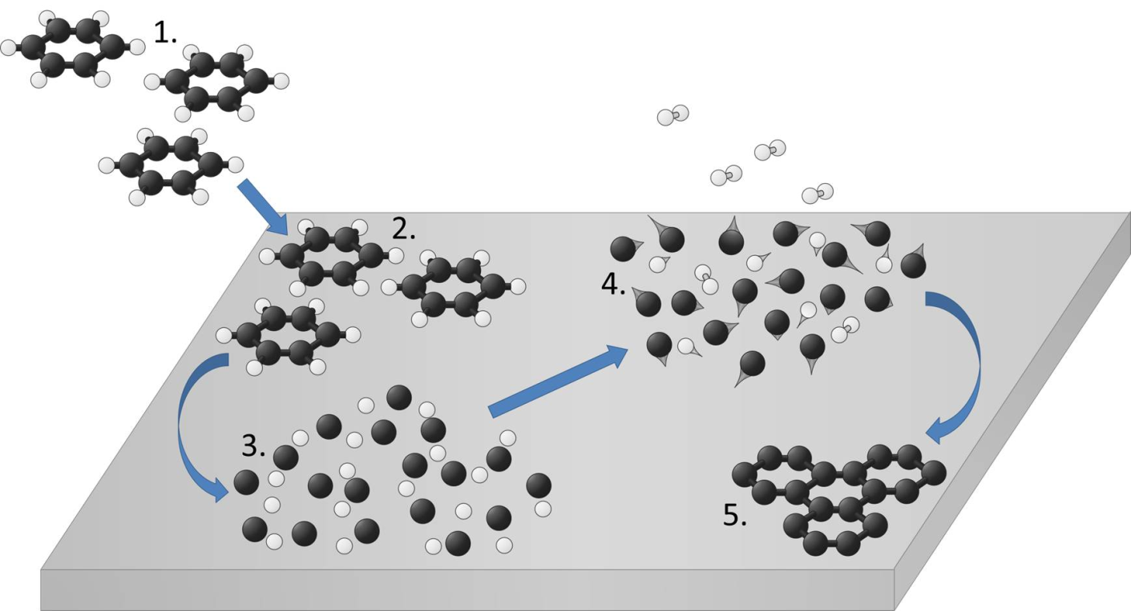
Epitaxial graphene is made like that …
PVD graphene
Physical Vapor Deposition
North Dakota State University
Dose C₆D₆ at low temperature
Collect D₂ TDS
Anneal sample
Repeat until D₂ signal disappears
Ru(0001)
UHV synthesis
ultra-high vacuum
self-terminating growth → single layer graphene
Chemical Physics Letters, 590 (2013) 146 - 152, by A. Chakradhar, K.M. Trettel, and U. Burghaus
Notes:
Graphene was made by decomposing benzene on ruthenium, see
Benzene adsorption on Ru(0001) and graphene/Ru(0001) — How to synthesize epitaxial graphene without STM or LEED?,
Chemical Physics Letters, 590 (2013) 146 - 152,
by A. Chakradhar, K.M. Trettel,* and U. Burghaus
*NSF REU fellow
STM characterization of graphene/Ruthenium
Structural properties and site specific interactions of Pt with the graphene/ Ru(0001) moiré overlayer
J. Chem. Phys. 131, 164701 (2009); https://doi.org/10.1063/1.3246166
Kerstin Donner and Peter Jakob
Directed self-assembly of monodispersed platinum nanoclusters on graphene Moiré template
Appl. Phys. Lett. 95, 093106 (2009); https://doi.org/10.1063/1.3223781
Yi Pan, Min Gao, Li Huang, Feng Liu, and H.-J. Gao

Slide 8
Epitaxial graphene is made like that …
PVD graphene
Physical Vapor Deposition
North Dakota State University
defect density < 5%
χ(L) gas exposure in Langmuir
L: Langmuir, 1 L = 1 sec gas exposure at 1x10⁻⁶ torr
Chemical Physics Letters, 590 (2013) 146 - 152, by A. Chakradhar, K.M. Trettel, and U. Burghaus
Notes:
Graphene was made by decomposing benzene on ruthenium, see
Benzene adsorption on Ru(0001) and graphene/Ru(0001) — How to synthesize epitaxial graphene without STM or LEED?,
Chemical Physics Letters, 590 (2013) 146 - 152,
by A. Chakradhar, K.M. Trettel,* and U. Burghaus
*NSF REU fellow

Slide 9
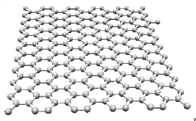
Auger - sample characterization
North Dakota State University
 | AES peak position for E₀ = 3keV
C | 272
Ru | 273, 231, 200, 184, 176, 150, 37
S | 152
O | 503, 483, 468
AES - Auger electron
spectroscopy
Notes:
Left hand side
Auger electron spectra of the clean ruthenium support and graphene on that support.
Since Ru and C AES peaks overlap, the p/n peak ratio is used as a characterization.
According to STM works (e.g., see Goodman, et al.) and other spectroscopy the p/n ratios obtained here are characteristic of clean Ru and a single atom thick layer of carbon on it.

Slide 10
Auger - sample characterization
North Dakota State University
p/n ratios
Ru(0001) | Graphene/Ru(0001) | Ref.
--- | 0.5 | Z. Zhou, B.F. Habenicht, Q. Guo, Z. Yan, Y. Xu, L. Liu, D.W. Goodman, Surf. Sci. 611 (2013) 67
0.8 | 0.46 | Li Liu a, Zihao Zhou a, Qinlin Guo b, Zhen Yan a, Yunxi Yao a, D. Wayne Goodman, Surface Science 605 (2011) L47–L50
0.76 ± 0.02 | 0.34 ± 0.02 | A. Chakradhar, K.M. Trettel ,U. Burghaus, Chemical Physics Letters 590, 146-152, (2013)
0.74 | 0.34 | A. Chakradhar , U. Burghaus, Chemical Communications 50, 7698 - 7701, (2014)
0.74 | 0.48 | Supplemental to N. Sivapragasam, M.T. Nayakasinghe ,U. Burghaus, J. Vac. Sci. Technol. 34, 041404, (2016)
Notes:
Left hand side
Auger electron spectra of the clean ruthenium support and graphene on that support.
Since Ru and C AES peaks overlap, the p/n peak ratio is used as a characterization.
According to STM works (e.g., see Goodman, et al.) and other spectroscopy the p/n ratios obtained here are characteristic of clean Ru and a single atom thick layer of carbon on it.

Slide 11
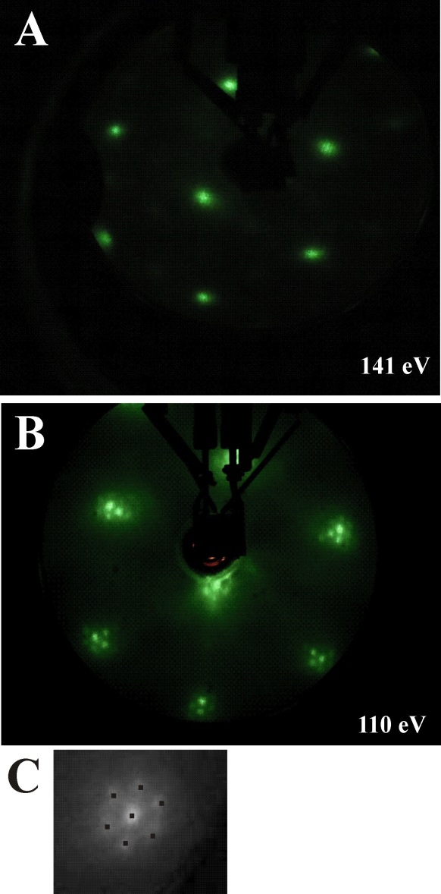
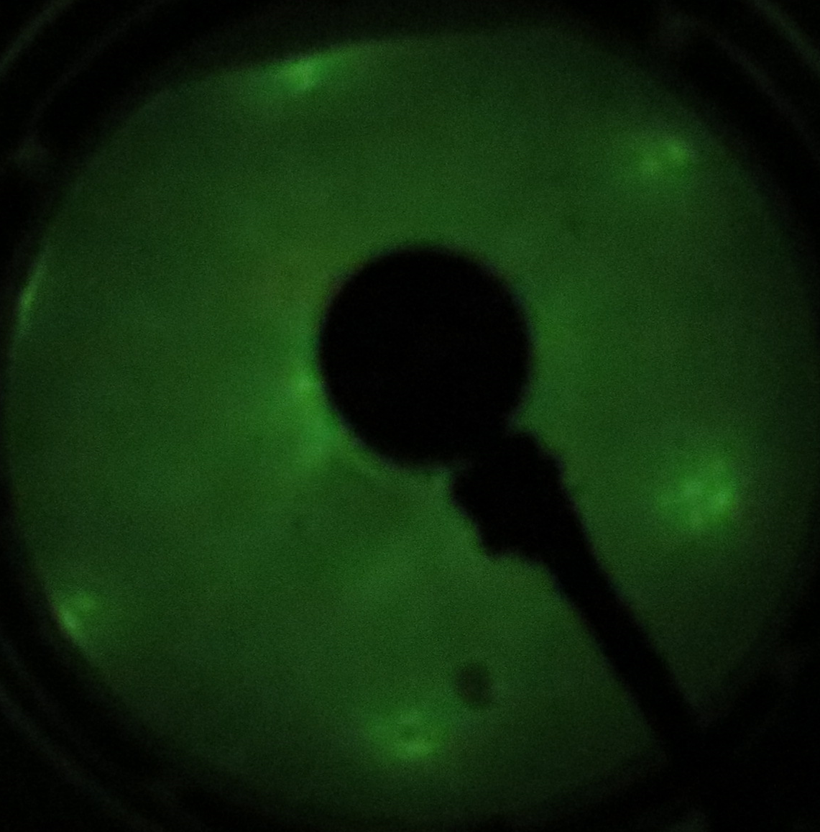
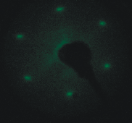

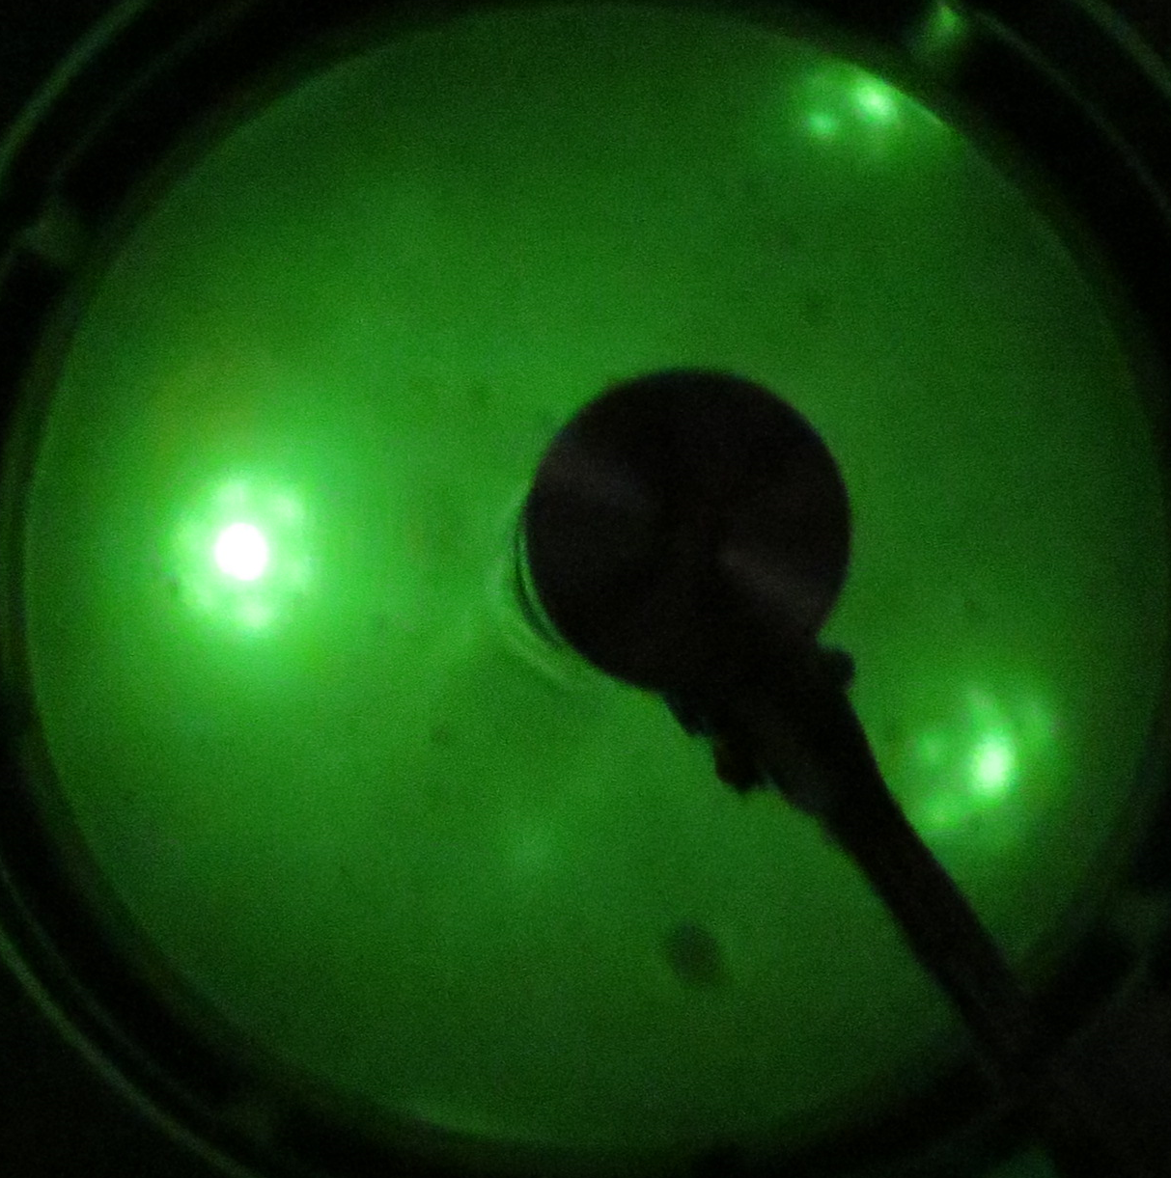

LEED - sample characterization
Sample 1
North Dakota State University
Sample 2
Ru
A
Gr/Ru
B
Ru
95 eV
97 eV
Gr/Ru
C
Gr/Ru
X
X
X
X
X
X
X
X
X
43 eV
X
X
Gr/Ru graphene/Ruthenium(0001)
LEED: Low Energy Electron Diffraction
Notes:
Right hand side
As also discussed in ref. [Effects of surface impurities on epitaxial graphene growth, Valeria del Campo, Ricardo Henríquez, Patricio Häberle, Applied Surface Science 264 (2013) 727-731 ] obtaining good LEED images of graphene’s/ruthenium Moré structure is difficult due to lack of perfect focusing and photographic problems. Having all satellite peak in focus with the same settings of the LEED system was not possible. However, the extra LEED spots surrounding the substrate LEED pattern are evident. A) LEED of graphene at 95 eV, B) LEED of clean ruthenium at 97 eV, C) LEED of graphene at 43 eV, here the sample was rotated by a few degrees, i.e., sample was not parallel to the LEED screen. Highlighted are the satellite pots using the letter “x”.
LEED images for two different graphene samples are shown

Slide 12
North Dakota State University
SO₂
Just published
Adsorption and Reaction Kinetics of SO2 on Graphene: an Ultra-high Vacuum Surface Science Study
J. Vac. Sci. Technol. A, in press, Vol.39, Issue 4
by Thomas Stach, Melody C. Johnson, Samuel Stevens, Uwe Burghaus
https://doi.org/10.1116/6.0001055
DOI: 10.1116/6.0001055
uwe.burghaus@ndsu.edu

Slide 13
Multi-mass TDS of SO₂
North Dakota State University
Sulfur does not desorb
Molecular adsorption pathway:
SO₂(ad)→SO₂(gas)
Reactive adsorption pathways:
2SO₂(ad) → 2SO(ad) + O₂(gas)
SO(ad)→SO(gas)
gas phase = TDS → molecular adsorption
ad: adsorption
gas: gas-phase species
Notes:
Left side
TDS, thermal desorption spectroscopy, curves for different masses.
Right side
Comparison of the SO₂ gas phase fragmentation pattern with the integrated TDS peak areas (/intensities).
Depicted is always the ratio of a given mass to the parent mass of SO₂.
E.g., S-TDS is the ratio of the integrated TDS peak areas of the mass spec. signals for m/e=32 (sulfur) with respect to m/e=64 (parent/molecular SO₂), or Sgas is the intensity ratio of m/e=32 (sulfur) with respect to m/e=64 (parent/molecular SO₂) for gas phase SO₂ (detected with the same mass spec.).
Main result:
SO and O TDS signals are larger than the corresponding SO₂ gas phase signal which suggests the decomposition of SO₂ since more SO and O are formed than expected for purely molecular SO₂.
More details:
The parent mass signal for SO₂ at m/e=64 (left side, black curve) must be related to molecular adsorption and desorption of SO₂. Since this signal is detected, we have evidence for the process
SO2(ad) → SO2(gas). (1)
A comparison of the TDS signals at various other masses with the corresponding SO₂ gas phase fragmentation pattern measured with the same mass spectrometer allows one to detect none-molecular adsorption/reaction pathways.
SO and O TDS signals are larger than the corresponding SO₂ gas phase signal (i.e., the gas phase fragmentation pattern) which would suggest
2SO₂(ad) → 2 SO(ad) + O₂(gas) (2)
SO(ad) → SO(g) (3)
Since all fragments desorb at the same and rather low temperature, a molecular adsorption/desorption pathway for SO seems likely.
Furthermore, the S TDS signal agrees with SO₂ gas phase fragmentation pattern of sulfur, i.e., sulfur does not desorb up to 600 K.
That TDS result is consistent with sulfur seen on the surface with AES (next slide) after the TDS experiments.
Therefore, another adsorption/reaction pathway must exist that generates sulfur such as
SO₂(ad) → S(ad) + O₂(des) (4)
or
2SO(ad) → 2 S(ad) + O₂(des) (5)
AES did not detect adsorbed oxygen after the TDS runs, i.e., O₂ indeed preferentially desorbs rather than forming graphene oxide. The p/n AES ratio of graphene slightly decreased after the TDS experiments, which indicates an increase of carbon on the surface. Thus, graphene seems not to decompose while interacting with SO₂. The increase in carbon likely is caused by our AES system, the micro CMA based AES is rather short. Therefore, carbon desorbs from the filament of the AES electron gun which is in line of sight to the sample. Thus, while collecting AES data some amorphous carbon is deposited on the surface.

Slide 14
Estimating reaction probability for SO₂ decomposition
North Dakota State University
2SO₂(ad) → 2SO(ad) + O₂(gas)
>
defect density < 5%
Ruling out that reactivity is solely defect related.

Slide 15
Auger after SO₂ TDS
North Dakota State University
SO₂(ad) → S(ad) + O₂(des)
and/or
2SO(ad) → 2 S(ad) + O₂(des)
Ruling out that reactivity is solely defect related.
Graphene remains intact, catalytic process.
post: intensity after SO₂ adsorption
pr: intensity prior SO₂ adsorption
AES sensitivity factors
Notes:
There is a Ru AES peak close to the S AES peak. However, the intensity in the S AES region clearly increases after the TDS experiments. Interestingly, also the Ru+S peak shifts towards the expected sulfur AES peak position consistent with the decomposition of SO₂ seen in the TDS experiments.
The estimate assumes that the Ru signal after the sulfur is adsorbed remains the same as for the clean surface.
That does ignore the attenuation of the Ru signal due to being covered by sulfur. Thus, the Ru signal after S deposition will be a bit smaller than for the clean surface. Thus, I_{post} is underestimated and so is I_{S}. The actual S coverage should be larger.

Slide 16
Parent-mass TDS of SO₂
North Dakota State University
α peak
Our study, α peak
(46.1 ± 0.5) kJ/mol to (36.8 ± 0.5) kJ/mol
DFT on free standing graphene much smaller
Gellman, 2009
35 kJ/mol HOPG
47 kJ/mol amorphous carbon
Condensation temperatures, c-peak
130 K | multilayer | our study
130 K | multilayer | Wassmuth, 1993
114 K, 104 K | bilayer trilayer | 31
128 K | multilayer | Steinrueck, 1997
c: condensation peak
α: molecular adsorption within monolayer range
Notes:
J. Ahner and H. W. Wassmuth, Surf. Sci. 287/288, 125 (1993).
P. Zebisch, M. Stichler, T. Trischberger, M. Weinelt and H. P. Steinrueck, Surf. Sci. 371, 235 (1997).
Gellman, Applied Catalysis A: General 362 (2009) 8–13

Slide 17
Proposed kinetics mechanism for SO₂ graphene/Ru - summary
North Dakota State University
molecular adsorption / desorption
Why? parent mass desorbs
SO₂(ad) → SO₂(gas)
E_{d} = 46.3 - 9.6 Θ kJ/mol
2SO₂(ad) → 2 SO(ad) + O₂(gas)
SO formation / desorption
Why? SO signal stronger than gas-phase fragmentation
Reaction probability
SO(ad) → SO(g)
Side reactions consuming O₂
Why? O₂ signal stronger than gas-phase fragmentation, but smaller than stoichiometry would predict
S(ad) +2O(ad)→SO₂(ad)
SO₂(ad) → S(ad) + O₂(des)
Sulfur formation
Why? S detected by Auger
2SO(ad) → 2 S(ad) + O₂(des)
Notes:
Noble metals
ruthenium (Ru),
rhodium (Rh),
palladium (Pd),
osmium (Os),
iridium (Ir),
platinum (Pt),
gold (Au),
silver (Ag).
Def.: In chemistry, noble metals are metallic elements that show outstanding resistance to chemical attack even at high temperatures.
https://en.wikipedia.org/wiki/Noble_metal

Slide 18
Proposed electronic mechanism
North Dakota State University
part of van der Waals interactions from a substrate are transmitted through graphene
hybridization of substrate and graphene orbitals
graphene defects as active sites
charge transfer from dopants to graphene
Current literature suggests as a working hypothesis for our project that epitaxial graphene can act as a catalyst due to hybridization of graphene’s carbon with the substrate.
Notes:
Possible mechanisms and working hypothesis
For developing a working hypothesis for the proposed projects, one may want to consider possible mechanisms explaining why a carbon-based system may become a catalyst. Searching the literature, several ideas become apparent.
1) Considering molecular adsorption. A few years back the adsorption of water on epitaxial graphene was a focus area.¹⁻⁷ Theoretical works suggested that at least part of van der Waals interactions from a substrate are transmitted through graphene, i.e., the polarization of the substrate can affect surface properties of graphene.⁴ That is not restricted to metallic substrates but, e.g., glass or silica as a substrate also can affect van der Waals type interactions.⁴
2) More important for our projects, for more covalent interactions a different mechanism was recently suggested.^{8, 9} In this combined experimental and DFT study, a hybridization of nickel (used as a substrate) and graphene orbitals was proposed to enhance the reactivity for CO adsorption.⁸ Graphene’s structure was not altered. Hybridization effects should not be restricted to metallic substrates. Metal substrates are primarily used in many studies so far simply because it’s easier to grow graphene on metals. If graphene on non-metallic systems also becomes reactive due to hybridization effects simply needs an experimental verification. First the reactivity can be characterized using kinetics techniques. Next, electronic structure properties become apparent in XPS data.
3) Liquid phase studies usually consider graphene (carbon flakes) not bound to a substrate. In most studies the graphene flakes are functionalized which determines the reactivity. For example, during oxidation of graphene, the sp² hybridized carbon of graphene changes to a sp³ in order to accommodate the oxygen.¹⁰ DFT studies have shown that the oxidation of graphene can form various oxygen containing functional groups: epoxide, hydroxyl, and carboxyl.¹¹ Both the aromaticity and the reactive oxygen containing functional groups in GO can act towards making GO a reactive material. Besides GO other functionalization have been shown to be effective. Many theoretical studies in the literature are devoted to understanding the mechanism by which functionalization modifies the reactivity of graphene. For example, the binding energy of Pt doubles by N-doping graphene. This DFT study suggests that the nitrogen atoms locally destabilize the delocalized double bond present in graphene.¹² Or, in an experimental study about H₂S oxidation by an N-doped carbon catalyst, it was suggested that nitrogen groups act as Lewis basic sites increasing the local basicity of coadsorbed water which facilitate the dissociation and subsequent oxidation of H₂S.¹³ Examples where a charge transfer from N or S dopands of graphene to adsorbates is invoked (leading to dissociation of the adsorbate) also can be found in the literature.¹⁴
4) Another mechanism is related to defects in graphene. According to a DFT study¹⁵ defects in graphene create C atoms with dangling bonds (i.e. unpaired valence electrons) which enhance graphene's reactivity. In particular, the dissociation of phenol was catalyzed by defects.¹⁵ Experimentally, the defect density of graphene can be manipulated by electron or ion bombardment using a sputter gun, or the electron gun from the Auger or LEED system. That again should be independent of the type of substrate (metal vs. non-metallic) used.
Current literature suggests as a working hypothesis for our project that epitaxial graphene can act as a catalyst due to hybridization of graphene’s carbon with a metallic or non-metallic substrate. And, a functionalization certainly modifies graphene’s electronic structure to become more reactive e.g. by charge transfer.
Uwe Burghaus
- Surface Chemistry | Het. Catalysis | Nanoscience | Materials -
North Dakota State University, Dept. Chemistry & Biochemistry
uwe.burghaus@ndsu.edu
www.uweburghaus.us
https://www.ndsu.edu/chemistry/people/faculty/burghaus.html
References
1 Burghaus, U., "Adsorption of water on two-dimensional crystals: water/graphene and water/silicatene (short review)" Inorganics 4, 10; http://www.mdpi.com/2304-6740/4/2/10/pdf (2016).
2 Rafiee, J., Mi, X., Gullapalli, H., Thomas, A. V., Yavari, F., Shi, Y., Ajayan, P. M. Koratkar, N. A., "Wetting transparency of graphene" Nature Materials 11, 217, (2012).
3 Shih, C. J., Wang, Q. H., Lin, S., Park, K. C., Jin, Z., Strano, M. S. Blankschtein, D., "Breakdown in the Wetting Transparency of Graphene" Phys. Rev. Lett. 109, 176101, (2012).
4 Shih, C. J., Strano, M. S. Blankschtein, D., "Wetting translucency of graphene" Nat. Mater. 12, 866, (2013).
5 Raj, R., Maroo, S. C. Wang, E. N., "Wettability of Graphene" Nano Lett. 13, 1509-1515, (2013).
6 Chakradhar, A. Burghaus, U., "Adsorption of water on graphene/Ru(0001)—an experimental ultra-high vacuum study" Chemical Communications 50, 7698 - 7701, (2014).
7 Chakradhar, A., Sivapragasam, N., Nayakasinghe, M. T. Burghaus, U., "Support effects in the adsorption of water on CVD graphene: an ultra-high vacuum adsorption study," Chemical Communications 51, 11463 - 11466, (2015).
8 Elias, D. C., Nair, R. R., Mohiuddin, T. Morozov, S. V., "Control of graphene's properties by reversible hydrogenation: evidence for graphane" Science 323, 610-613, (2009).
9 Balog, R., Jørgensen, B., Wells, J., Lægsgaard, E., Hofmann, P., Besenbacher, F. Hornekær, L., "Atomic Hydrogen Adsorbate Structures on Graphene" J. AM. CHEM. SOC. 131, 8744–8745, (2009).
10 Vinogradov, N. A., Schulte, K., Ng, M. L., Mikkelsen, A., Lundgren, E., Mårtensson, N. Preobrajenski, A. B., "Impact of Atomic Oxygen on the Structure of Graphene Formed on Ir(111) and Pt(111)" J. Phys. Chem. C 115, 9568, (2011).
11 Su, C. Loh, K. P., "Carbocatalysts: Graphene Oxide and Its Derivatives" Acc. Chem. Res. 46, 2275–2285, (2013).
12 Groves, M. N., Chan, A. S. W., Malardier-Jugroot, C. Jugroot, M., "Improving platinum catalyst binding energy to graphene through nitrogen doping" Chemical Physics Letters 481, 214-219, (2009).
13 Sun, F., Liu, J., Chen, H., Zhang, Z., Qiao, W., Long, D. Ling, L., "Nitrogen-Rich Mesoporous Carbons: Highly Efficient, Regenerable Metal-Free Catalysts for Low-Temperature Oxidation of H₂S" ACS Catal. 3, 862−870, (2013).
14 Wang, Y., Shen, Y., Zhou, Y., Xue, Z., Xi, Z. Zhu, S., "Heteroatom-Doped Graphene for Efficient NO Decomposition by Metal-Free Catalysis" ACS Appl. Mater. Interfaces 10, 36202−36210, (2018).
15 Widjaja, H., Oluwoye, I., Altarawneh, M., Hamra, A. A. B., Lim, H. N., Huang, N. M., Yin, C. Y. Jiang, Z. T., "Phenol dissociation on pristine and defective graphene" Surface Science 657, 10-14, (2017).

Slide 19
North Dakota State University
H₂S
Very recent data (unpublished)

Slide 20
Literature H₂S
North Dakota State University
Notes:
Adsorption and reaction of H₂S on graphene at ultra-high vacuum
1. Introduction
A. Motivation
Adsorption and reaction of H₂S on solid surfaces leads to complicated and interesting surface chemistry which is worthwhile to study on its own grounds.^{1, 2} Regarding applications, the largest industrial source of H₂S is generated by the hydrodesulfurization process in petroleum refineries, but also coke ovens, sewerage, paper mills, and tanneries generate it. Also, natural gas can include it. Therefore, energy efficient removal of H₂S gas is of practical interest^{3, 4} as well as H₂S sensors.⁵ Considering graphene and other carbon systems studies are besides scientific curiosity motived by developing noble metal free catalysts.⁶
B. Brief H₂S literature survey
To the best of our knowledge, H₂S adsorption or reaction on graphene has not been studied experimentally at ultra-high vacuum (UHV) conditions using surface science methods. However, related reference systems including other carbon surfaces and ruthenium (used in this study to form graphene) as well as theoretical projects are available in the literature.
Theory considering H₂S on pristine graphene: Using DFT (density functional theory) and vdW-DFT (van der Walls DFT), a weak physisorption (Tab. 1) of H₂S on free standing graphene was predicted theoretically (with binding energies from 18 kJ/mol to 34 kJ/mol)^{1, 7} with very little charge transfer from graphene to H₂S and only a weak hybridization of S 3p and C 2p orbitals.⁷ Nearly all DFT studies concern free standing graphene, although it is known that epitaxial graphene can have very different properties^{8, 9} and thick “graphene” flakes (mostly utilized in liquid phase studies) behave like HOPG¹⁰ (Highly Ordered Pyrolytic Graphite) rather than graphene. Therefore, a comparison of epitaxial graphene, graphene flakes and free standing DFT modeled graphene is problematic. Interestingly, in one recent DFT study the effect of the substrate (here nickel) was actually included.¹¹ It turned out, that graphene(p) and Ni(3d) states hybridization boosts graphene’s reactivity, as also seen experimentally^{8, 9} (in that case for CO adsorption). Graphene’s structure was not altered.
Theory considering H₂S on functionalized graphene: Whereas simple DFT modeling of free-standing graphene usually describes it as non-reactive, numerous theoretical studies predict reactivity enhancement when functionalizing graphene³ including H₂S induced S doping.¹ In a reactive process likely adsorbed sulfur is formed from H₂S. Sulfur’s binding energy on free standing graphene was calculated as 56 kJ/mol using DFT¹ as well as a significant H₂S binding strength enhancement in coadsorption with S to 169 kJ/mol was proposed theoretically.¹ Coadsorption of S and H₂S theoretically leads to the formation of HSSH which seems to clean off sulfur.¹ Interestingly, H₂S chemisorbs covalently on defect sites (vacancies), leading to dissociation to adsorbed sulfur and desorbing H₂.^{1, 2} Sulfur seems to become part of the graphene lattice (,i.e., graphene is doped by sulfur); S doped graphene adsorption sites also dissociate H₂S.¹
H₂S on other carbon surfaces: H₂S adsorption on various different amorphous carbon thin films (oxidized, N and H doped) and HOPG were studied by TDS (Thermal Desorption Spectroscopy) and XPS (X-ray Photoelectron Spectroscopy).¹² Molecular adsorption (/ 1st order desorption) was apparently seen only on the amorphous and oxidized carbon films with, amazingly, identical binding energies (Tab. 1). Several studies were conducted on activated carbon (AC).⁴ Numerous impurities/functionalities seem usually adsorbed on AC, which makes a comparison to UHV work difficult. E.g., in the presence of O₂ and water, H₂S can be oxidized to SO₂ and sulfur. Sulfur desorption was seen at 750 K in derivative thermogravimetry (DTG) of AC.¹³
H₂S on Ru: In this study, Ru(0001) is used as a substrate to grow graphene. According to LEED (Low Energy Electron Diffraction), UPS (Ultraviolet Photoelectron Spectroscopy), AES (Auger Electron Spectroscopy), and TDS above 350 K, H₂S decomposed to adsorbed sulfur and desorbing H₂.¹⁴ The low coverage heat of adsorption of H₂S amounts to 105 kJ/mole.¹⁴ Even annealing the surface at high temperature for an extended period of time (~1400 K for 5-30 min) did not completely desorb sulfur.
Possible (side) reactions
H2S + 1/2O2 → S° + H2O
H2S + 3/2O2 → SO2 + H2O
SO2 + H2O + 1/2O2 → H2SO4
S° + O2 → SO2 + O2 → H2SO4
SO2 + C → S + CO2
References
1 Faye, O., Raj, A., Mittal, V. Beye, A. C., "H₂S adsorption on graphene in the presence of sulfur: A density functional theory study" Computational Materials Science 117, 110–119, (2016).
2 Borisova, D., Antonov, V. Proykova, A., "Hydrogen Sulfide Adsorption on a Defective Graphene" International Journal of Quantum Chemistry 113, 786–791, (2013).
3 Faye, O., Eduok, U., Szpunar, J., Samoura, A. Beye, A., "H₂S adsorption and dissociation on NH-decorated graphene: A first principles study" Surface Science 668, 100–106, (2018).
4 Bagreev, A., Rahman, H. Bandosz, T. J., "Study of regeneration of activated carbons used as H₂S adsorbents in water treatment plants" Advances in Environmental Research 6, 303-311, (2002).
5 Reshak, A. H. Auluck, S., "Adsorbing H₂S onto a single graphene sheet: A possible gas sensor" JOURNAL OF APPLIED PHYSICS 116, 103702, (2014).
6 Sun, F., Liu, J., Chen, H., Zhang, Z., Qiao, W., Long, D. Ling, L., "Nitrogen-Rich Mesoporous Carbons: Highly Efficient, Regenerable Metal-Free Catalysts for Low-Temperature Oxidation of H₂S" ACS Catal. 3, 862−870, (2013).
7 Mohammadi-Manesh, E., Vaezzadeh, M. Saeidi, M., "Cu- and CuO-decorated graphene as a nanosensor for H₂S detection at room temperature" Surface Science 636, 36–41, (2015).
8 Celasco, E., Carraro, G., Smerieri, M., Savio, L., Rocca, M. Vattuone, L., "Influence of growing conditions on the reactivity of Ni supported graphene towards CO" THE JOURNAL OF CHEMICAL PHYSICS 146, 104704 (2017).
9 Smerieri, M., Celasco, E., Carraro, G., Lusuan, A., Pal, J., Bracco, G., Rocca, M., Savio, L. Vattuone, L., "Enhanced Chemical Reactivity of Pristine Graphene Interacting Strongly with a Substrate: Chemisorbed Carbon Monoxide on Graphene/Nickel(111)" ChemCatChem 7, 2328 – 2331, (2015).
10 Shih, C. J., Strano, M. S. Blankschtein, D., "Wetting translucency of graphene" Nat. Mater. 12, 866, (2013).
11 Ambrosetti, A. Silvestrelli, P. L., "Communication: Enhanced chemical reactivity of graphene on a Ni(111) substrate" The Journal of Chemical Physics 144, 111101, (2016).
12 Michalak, W., Broitman, E., Alvin, M. A., Gellman, A. J. Miller, J. B., "Interactions of SO₂ and H₂S with amorphous carbon films" Applied Catalysis A: General 362, 8-13, (2009).
13 BAGREEV, A., RAHMAN, H. BANDOSZ, T. J., "Study of H₂S Adsorption and Water Regeneration of Spent Coconut-Based Activated Carbon" Environ. Sci. Technol. 34, 4587-4592, (2000).
14 KELEMEN, S. R. FISCHER, T. E., "INTERACTION OF H2S WITH THE Ru(00l) SURFACE " Surface Science 87, 53-68, (1979).
15 Hegde, V. I., Shirodkar, S. N., Tit, N., U.V.Waghmare Yamani, Z. H., "First principles analysis of graphene and its ability to maintain long-ranged interaction with H₂S" Surface Science 621, 168–174, (2014).

Slide 21
Parent-mass TDS of H₂S
North Dakota State University
H₂S(ad) → H₂S(gas)
c: condensation peak
α: molecular adsorption within monolayer range
Notes:
Set of H₂S TDS curves where H₂S was dosed at ~100 K on graphene/Ruthenium. The parent mass was collected. Exposures, χ, are given in Langmuir. The a-peak denotes a monolayer feature.

Slide 22
Theory vs. experiment for H₂S – molecular pathway
North Dakota State University
System | Binding energy in kJ/mol | Ref.
DFT
Gr | <17.8 | ¹
Gr | 34 | ²
Gr | 15.4 | ³
S-Gr (coadsorption) | 169 | ²
Stone–Wales defects | 25.7 | ³
Single vacancy defects | dissociates | ^{2, 4}
S doped Gr | dissociates | ²
Experimental
Amorphous C film and oxidized film | (39-30) ± 1 | ⁵
HOPG | <24 | ⁵
graphene/Ru | 33.1 ± 0.5 | Our project
“DFT – Gr”: free standing graphene
Effect of support NOT included in current DFT for graphene/Ru.
1 Mohammadi-Manesh, E., Vaezzadeh, M. Saeidi, M., "Cu- and CuO-decorated graphene as a nanosensor for H₂S detection at room temperature" Surface Science 636, 36–41, (2015).
2 Faye, O., Raj, A., Mittal, V. Beye, A. C., "H₂S adsorption on graphene in the presence of sulfur: A density functional theory study" Computational Materials Science 117, 110–119, (2016).
3 Hegde, V. I., Shirodkar, S. N., Tit, N., U.V.Waghmare Yamani, Z. H., "First principles analysis of graphene and its ability to maintain long-ranged interaction with H₂S" Surface Science 621, 168–174, (2014).
4 Borisova, D., Antonov, V. Proykova, A., "Hydrogen Sulfide Adsorption on a Defective Graphene" International Journal of Quantum Chemistry 113, 786–791, (2013).
5 Michalak, W., Broitman, E., Alvin, M. A., Gellman, A. J. Miller, J. B., "Interactions of SO₂ and H₂S with amorphous carbon films" Applied Catalysis A: General 362, 8-13, (2009).
Binding energies of H₂S on pristine and functionalized graphene (Gr) as well as amorphous carbon films. (A 1st order pre-exponential of 1x10¹³/s was assumed for the experimental TDS data analysis.)
Notes:
1 Mohammadi-Manesh, E., Vaezzadeh, M. Saeidi, M., "Cu- and CuO-decorated graphene as a nanosensor for H₂S detection at room temperature" Surface Science 636, 36–41, (2015).
2 Faye, O., Raj, A., Mittal, V. Beye, A. C., "H₂S adsorption on graphene in the presence of sulfur: A density functional theory study" Computational Materials Science 117, 110–119, (2016).
3 Hegde, V. I., Shirodkar, S. N., Tit, N., U.V.Waghmare Yamani, Z. H., "First principles analysis of graphene and its ability to maintain long-ranged interaction with H₂S" Surface Science 621, 168–174, (2014).
4 Borisova, D., Antonov, V. Proykova, A., "Hydrogen Sulfide Adsorption on a Defective Graphene" International Journal of Quantum Chemistry 113, 786–791, (2013).
5 Michalak, W., Broitman, E., Alvin, M. A., Gellman, A. J. Miller, J. B., "Interactions of SO₂ and H₂S with amorphous carbon films" Applied Catalysis A: General 362, 8-13, (2009).

Slide 23
Auger after H₂S TDS
North Dakota State University
H₂S(ad) → S(ads) + ???

Slide 24
Possible reaction pathways for H₂S
North Dakota State University
H₂S gas phase fragments
(NIST database)
m/e = 34, parent mass
m/e = 33, HS ?
m/e = 32, S
m/e = 35, 36 (weak)
Side reactions:
H₂S + 1/2O₂ → S° + H₂O
H₂S + 3/2O₂ → SO₂ + H₂O
SO₂ + H₂O + 1/2O₂ → H₂SO₄
S° + O₂ → SO₂ + O₂ → H₂SO₄
SO₂ + C → S + CO₂
Water m/e = 18
CO m/e = 28
CO₂, m/e = 44
OH, m/e = 16
H₂SO₄ m/e = 80, 64, 48, 98
SO₂, SO₃,SO₄ …
Possible reaction products:
m/e = 1, 2 (H, H₂)
m/e = 32, (S)
HSSH formation (theory paper)
m/e = 66
Notes:
What masses should we look for in TDS?
Apparently, H2S has no H2 or H signal in the gas phase.
There is a UHV background signal, but …

Slide 25
Multi-mass TDS for H₂S adsorption
H₂S(ad) → S(ads) + ???
North Dakota State University
H₂S(ads) → S(ads) + 2H(ads)
2H(ads)→H₂(gas)
2H₂S(ads) → 2SH(ads) + 2H(ads)
SH(ads)→SH(gas)
2H(ads)→H₂(gas)
Notes:
We have collected multi mass TDS, but it seems that the TDS pattern does match the gas phase fragmentation. Thus, this is just consistent with the molecular ads./des. pathway. The reaction product masses do not coincide with the gas phase fragmentation.
But, we do see mostly H2 desorption which is a reaction product.
We need to repeat this more quantitatively.

Slide 26
Conclusions
North Dakota State University
D₂ TDS: graphene's defect density below 5% ML
TDS & AES: SO₂ and H₂S on graphene/Ru(0001)
SO₂ and H₂S adsorb molecularly
deviations of the gas-phase fragmentation pattern and multi-mass TDS for SO₂
SO and O₂ desorbs in SO₂ TDS experiments
Mostly H₂ desorbs in H₂S experiments
Sulfur remains adsorbed up to 800 K for both probe molecules
AES revealed adsorbed sulfur after the kinetics experiments
Research presented was supported by ND EPSCoR
ND EPSCoR STEM Solicitation – Seed Award
uwe.burghaus@ndsu.edu
Notes:
The adsorption of SO₂ and H2S on graphene/Ru(0001) were studied by TDS and AES.
A defect density of the single layer graphene much below 5% of a monolayer was detected by D₂ TDS while synthesizing the samples.
SO₂ and H2S adsorb molecularly as well as decomposes.
Deviations of the gas-phase fragmentation pattern and multi-mass TDS pattern were observed.
SO and O₂ desorbs in TDS experiments
AES revealed adsorbed sulfur after the kinetics experiments.

Slide 27
Acknowledgement
North Dakota State University
Research presented was supported by ND EPSCoR
ND EPSCoR STEM Solicitation – Seed Award
Talk available at
http://uweburghaus.us/
uwe.burghaus@ndsu.edu
Notes:
I usually do not look like Monte Cristo, that photo was made during the Pandemic…. Uwe Burghaus
fund number 46200
project number FAR0033873
10/16/2020-05/31/2021
NDSU award FAR0031578
PI Uwe Burghaus
Thomas Stach, Melody C. Johnson, Samuel Stevens, Uwe Burghaus
Department of Chemistry and Biochemistry, NDSU, Fargo, ND
Adsorption and reaction of SO2 and H2S on graphene/ruthenium(0001) - an ultra-high vacuum surface science study
Noble metal-free catalysis using (functionalized) carbon is an emerging alternative to traditional chemical synthesis. Examples are known for liquid phase and gas-phase reactions. In particular, reactivity towards adsorption and reaction of sulfur compounds has been demonstrated in the literature. However, gas-surface reactions are not well characterized. In this study, kinetics techniques (thermal desorption spectroscopy) and spectroscopy (Auger electron spectroscopy) indeed show that SO2 and H2S undergo chemical transformations on graphene epitaxially grown on ruthenium. In case of SO₂, SO and O₂ desorb, sulfur remains on the surface. In addition, a molecular adsorption pathway is evident.

Slide 29
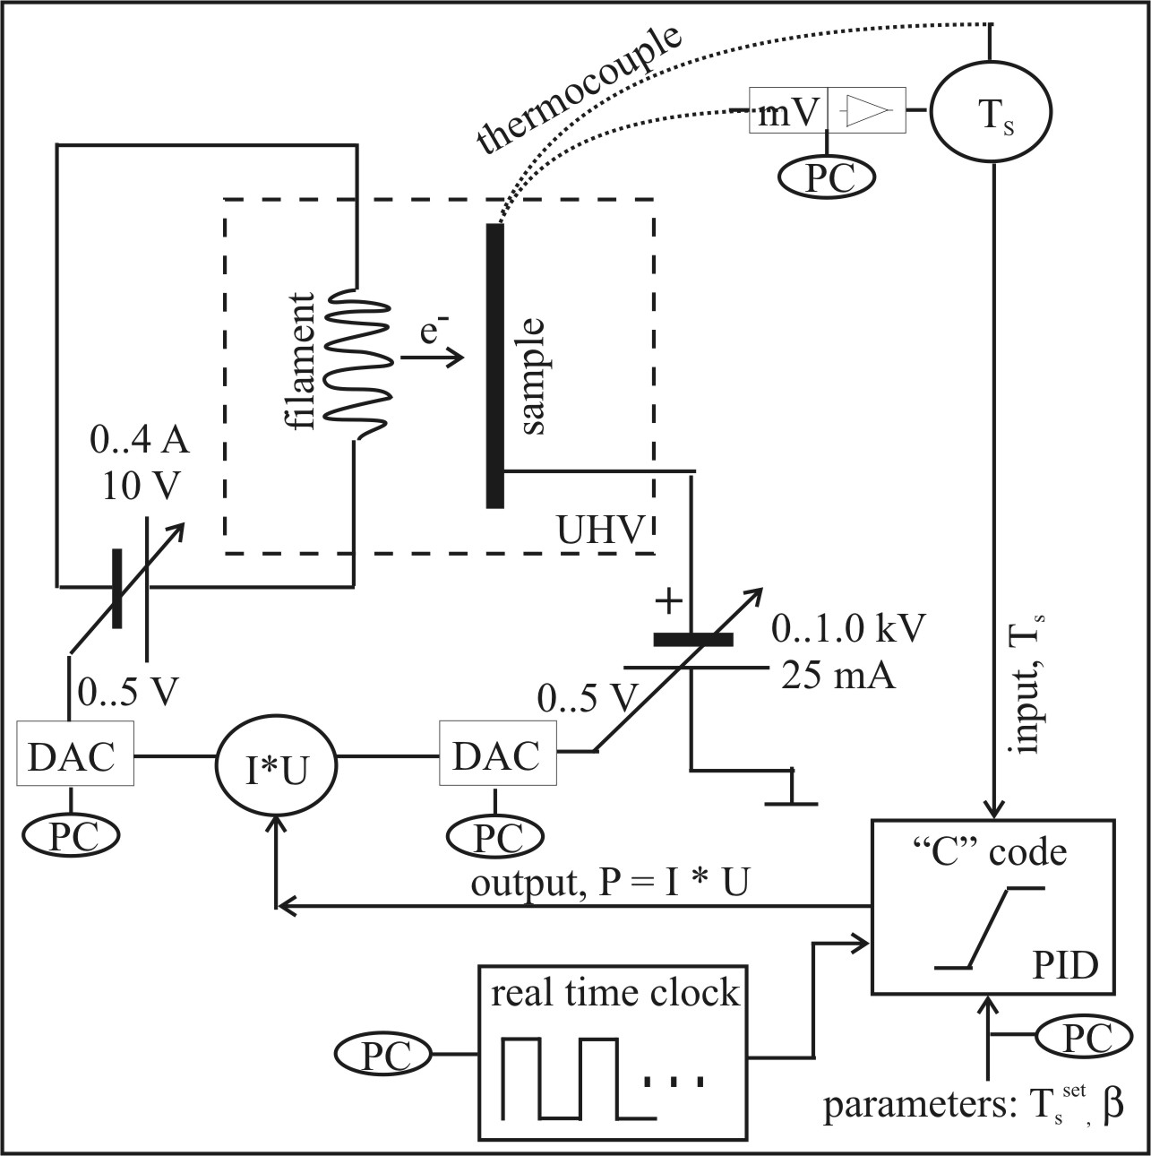
Setup (more details) -- thermal desorption spectroscopy
6
Notes:
Surface chemists should know that two different “concepts” exist to set up an electron bombardment heating system.
The simplest one sets the sample at high voltage, see left hand side.
For electron spectroscopy it is, however, required having the sample at ground potential if one would like to study effects of the surface temperature. In that case isolated power supplies are required. How this can be done is shown on the right-hand side of this slide. This is more tricky and can be dangerous if not properly designed.
In addition, some set-ups use direct ohmic heating of the samples.

Slide 30
You would not like to see this … sample characterization
North Dakota State University
graphene / SiO₂
Raman
LEED
Auger
XPS
XPS: X-ray Photoelectron Spectroscopy
LEED: Low Energy Electron Diffraction

